Slide 1
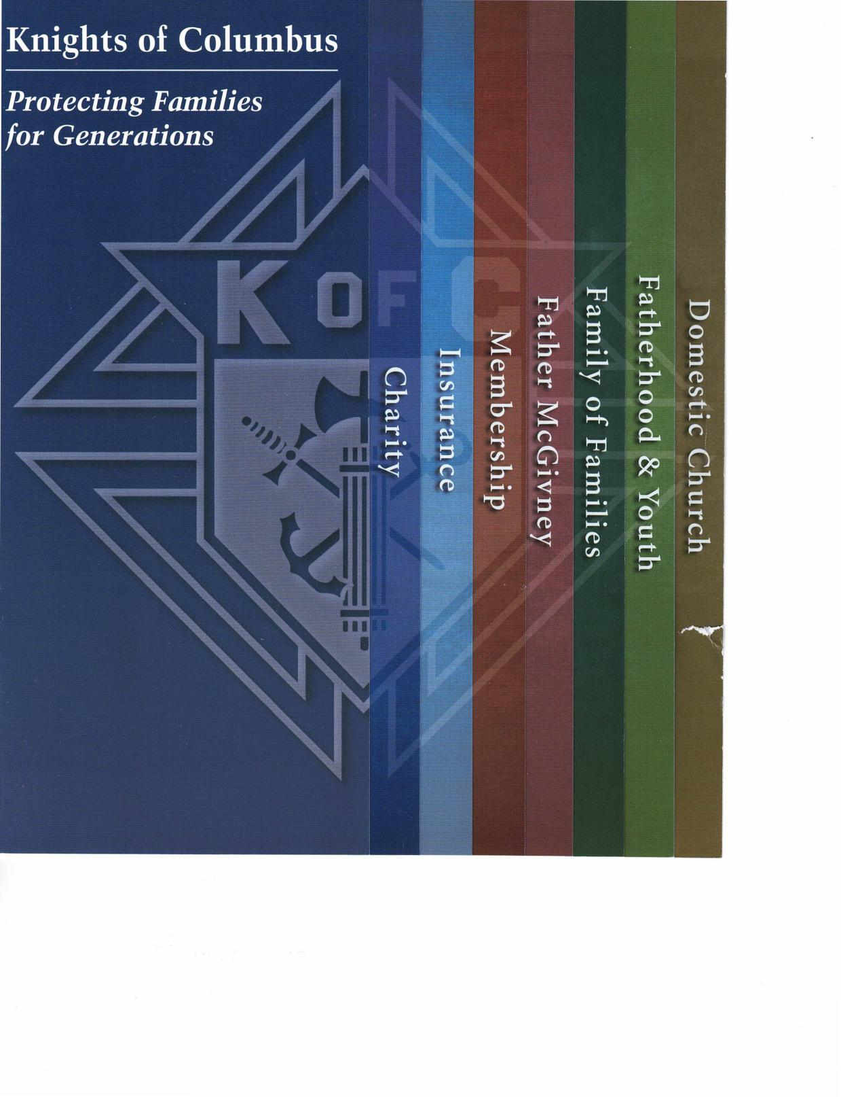
Knights of Columbus
Protecting Families for Generations
sawured Jo Allured
tilnoA )R pompagled
Aauni[DDIAT iaql⁻e3
qping3 Dpsamou
dp4siaquials
apu⁻einsui

Slide 2
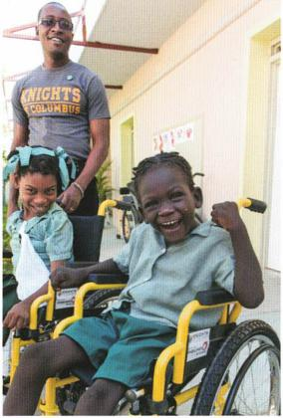
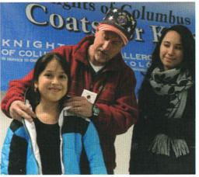
Being Our Brother'
Keeper
samtuud Jo All 'mud
qi.noA pootpatRed | tpintID DITsatuoci
Living a Charity
that Evangelizes
When Father Michael J. McGivney founded the Knights of Columbus, he brought together Catholic men to protect and serve local families and communities.
Today, on a global scale, members of the Order continue this mission, responding to diverse needs throughout the world. In the past decade alone, the Knights of Columbus has donated more than $1.5 billion and nearly 700 million volunteer hours to charitable causes.
Building Communities
Serving Those Who Served
Serving countless military personnel through many local council initiatives, the Knights of Columbus works to help soldiers find spiritual support, hope and healing — particularly through its work at VA hospitals and its partnership with the Archdiocese for the Military Services, USA.
The Order also works with the Gary Sinise Foundation, helping fund custom smart-homes for veterans who are disabled.
Responding to Our Neighbors' Most Urgent Needs
The Knights of Columbus often responds to natural and man-made disasters that arise around the globe.
Children in Haiti provided with rehabilitation and prosthetics after a 2010 earthquake
Fishermen in the Philippines equipped with boats after Typhoon Haiyan ravaged the country in 2013
Victims of the devastating floods that hit southern Louisiana received support in the way of donations of money, food, supplies, rebuilding and assistance in finding temporary housing
The Knights of Columbus helps build a culture of life through its partnership with Special Olympics.
Sponsorship of athletes participating in 2015 Summer World Games
Millions of dollars raised and thousands of volunteer hours donated
The Knights of Columbus has begun the Christian Refugee Relief Fund.
More than $13 million provided to care for the thousands suffering religious persecution in the
apuuinsui
Knights help their local communities through various service programs such as Coats for Kids and Food for Families. They also partner with organizations such as Habitat for Humanity and the Global Wheelchair Mission.
Protecting the Most Vulnerable
The Knights of Columbus is
dedicated to protecting the dignity of all human life, from the moment of conception until natural death.
The Knights of Columbus Ultrasound Initiative has been a successful part of our efforts, saving lives by providing ultrasound machines to pregnancy resource centers since 2009. Additionally, through its support of the March for Life, the Order remains on the front lines of the pro-life movement.
Middle East
A month's amount of food supplied to 13,500 refugees in Iraq
More than $1,000,000 donated to relief efforts in Ukraine since 2014

Slide 3
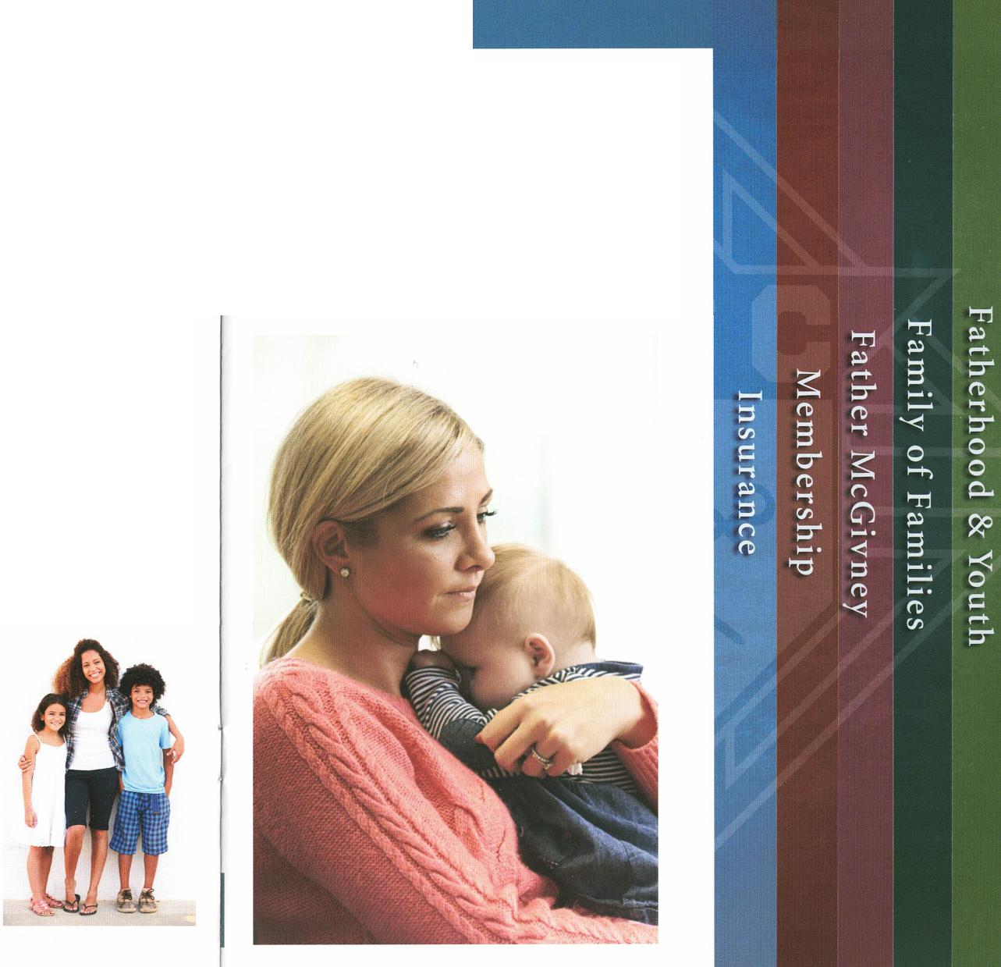
Protecting Families for Generations
Insurance for
Brother Knights by Brother Knights
Affordable Protection for Catholic Families
The Knights of Columbus offers a complete portfolio of top-quality products to members and their eligible family members.
Permanent Insurance
Term Insurance
Disability Income Insurance
Long-Term Care Insurance
Retirement Annuities
In addition, members are also eligible for a number of free fraternal benefits and complimentary services, such as a financial needs analysis and the Knights of Columbus Personal Planning Workbook.
Founded by a Priest to Protect Catholic Families
From its beginning, the Knights of Columbus has been in the business of providing financial protection to members and their families. In the 1880s, our venerable founder, Father Michael J. McGivney, initiated a "pass-the-hat" system to help provide for widows and orphans.
Today, the Knights of Columbus remains committed to his founding vision of financial protection through its top-rated, multi-billion dollar insurance program.
Catholic, Ethical and Charitable
The Knights of Columbus is not only financially strong, but unapologetically Catholic and ethically sound. As a matter of principle, the Knights of Columbus does not invest in companies that deal in abortions, contraception, human cloning, embryonic stem cell research, for-profit health care that pays for any of the aforementioned, and pornography. In recent years, the Knights of Columbus has continued to be recognized as a World's Most Ethical Company by the Ethisphere Institute. And, thanks in part to proceeds from the insurance program, the Knights of Columbus has donated more than $1.5 billion to charitable and religious causes in the last decade.
41 consecutive years of A.M. Best's highest rating, A++ (Superior), for financial strength
Fortune 1000 company with more than $105 billion of life insurance in force
50th largest life insurer in North America (ranked by Best's Statistical Study according to assets)
More than 2 million active contracts

Slide 4
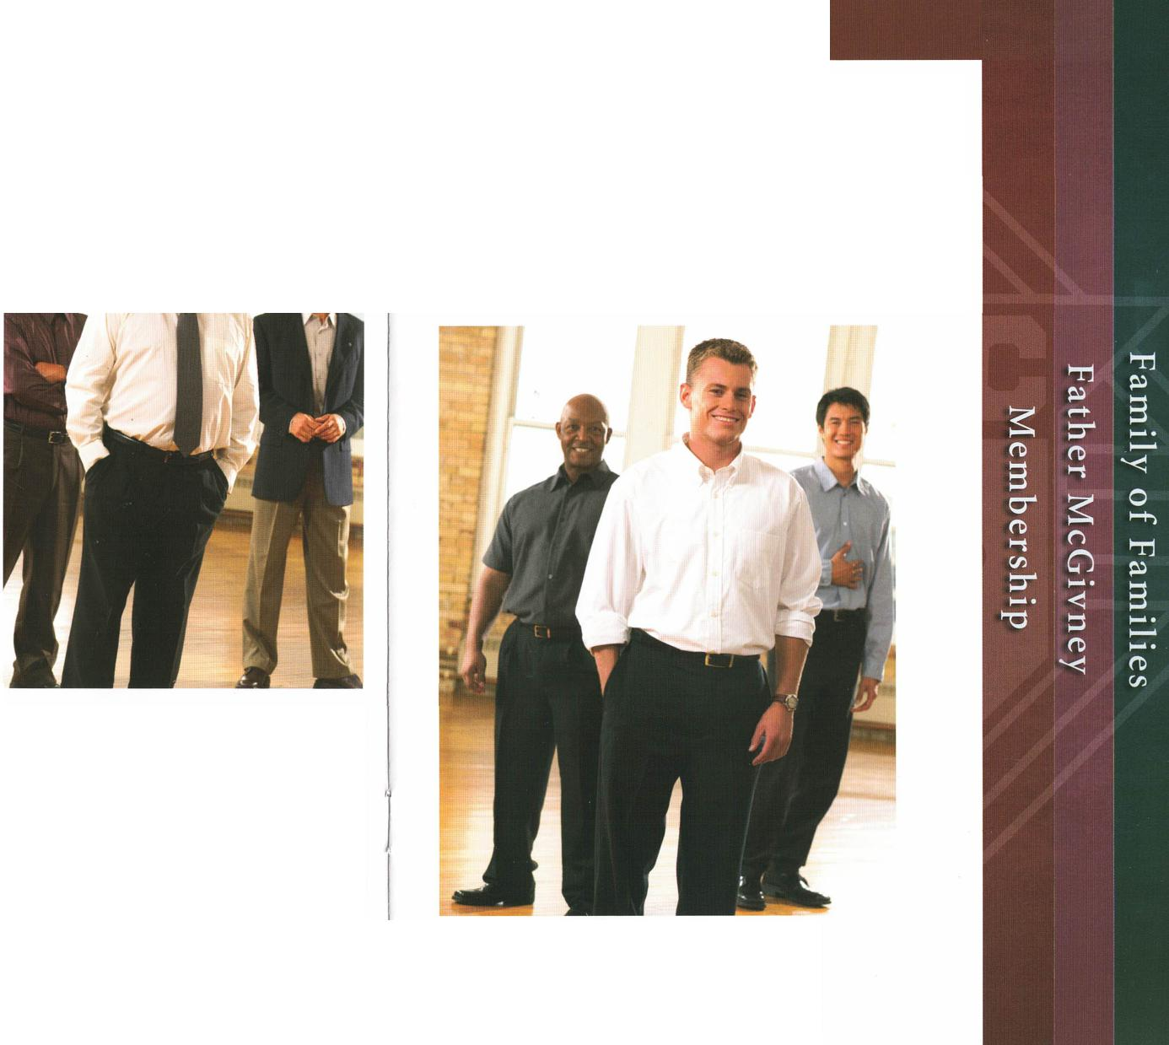

Joining a True Brotherhood of Catholic Men
Enriching Your Life through Service and Faith
Strengthen Your Family's Future
The Knights of Columbus provides opportunities to protect your family's financial future through its exclusive, top-rated insurance program.
Join a band of brothers who share your faith, your values, your commitment to family and your enthusiasm to serve the community.
A secure investment in a turbulent economy, Knights of Columbus Insurance has grown for 15 consecutive years.
Named a World's Most Ethical Company by the Ethisphere Institute multiple times, the Knights of Columbus has also earned the top ranking, A++(Superior), from global rating agency A.M. Best for 40 years.
I I
Serve Your Community
When you join
the Knights of
Columbus, you
will have the
opportunity to
help your parish
and other
communities
throughout the world.
Knights serve their neighbors through many services and initiatives:
Coats for Kids
Food for Families
Disaster relief
Charity
Unity
Fraternity
Patriotism
Four principles.
Four reasons
to join.
Programs for those with intellectual and physical disabilities
Spiritual and financial support for seminarians and religious
Pro-life programs
Grow Your Faith
The Knights of Columbus gives Catholic men the opportunity to pray together, strengthen their faith and serve the Church.
Knights of Columbus live out the
active spirituality of founder
Father Michael J. McGivney
by practicing a charity that evangelizes.

Slide 5
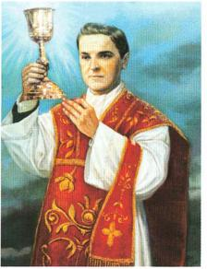
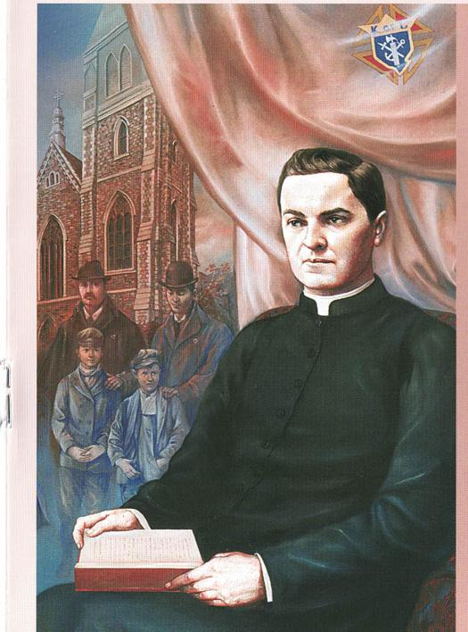
Father McGivney: A Model for Our Times
Prayer for the Canonization of
Father Michael J. McGivney
God, our Father, protector of the poor and defender of the widow and orphan, you called your priest, Father Michael J. McGivney, to be an apostle of Christian family life and to lead the young to the generous service of their neighbor. Through the example of his life and virtue may we follow your Son, Jesus Christ, more closely, fulfilling his commandment of charity and building up his Body which is the Church. Let the inspiration of your servant prompt us to greater confidence in your love so that we may continue his work of caring for the needy and the outcast. We humbly ask that you glorify your venerable servant Father Michael J. McGivney on earth according to the design of your holy will. Through his intercession, grant the favor I now present (here make your request).
Through Christ our Lord.
Amen.
Aparish priest, apostle to the young, protector of Catholic family life and founder of the Knights of Columbus, Venerable Servant of God Father Michael J. McGivney exercised heroic virtue in serving the temporal and spiritual needs of his people. Father McGivney's spirituality was grounded in acts of charity that evangelized, and 125 years after his death, he is still a model for our times.
A Priest for the Family
Father McGivney knew well the hardships that his parishioners endured as Catholics in 19th-century America.
 | 1
Aaun!DDIAT Jatuted
As a parish priest, he understood that the family was the center of Christian life and sought to recreate a "family of families" by immersing himself in the daily struggles of his flock.
 | Join the Guild Today! When you join the Father McGivney Guild, you receive many spiritual benefits. The intentions of guild members are included in a weekly Mass and several novenas celebrated during the liturgical year. Members also receive prayer cards and the bimonthly guild newsletter. Membership is free and open to any person who wishes to enhance his or her spiritual life and learn more about Father McGivney.
 |  | To join, visit fathermcgivney.org.
Evangelizer of His Community
Father McGivney's active pastoral care for those in all walks of life
"His special vocation was to develop Catholic manhood, to bind into one conspicuous solidarity all the elements that make for strength of character."
- Father Joseph Gordian Daley
was renowned. Caring especially for those on the margins of society, his service extended to immigrants, the imprisoned, and those Catholics of the time who were ostracized for their faith.
Founder of the Knights of Columbus
Seeking to provide fraternal support and spiritual guidance to the families of his parish, Father McGivney brought together a group of men at St. Mary's Church in New Haven, Conn., to form the Knights of Columbus in 1882.
Together, they would build a model of charity and unity, working on behalf of those in need and establishing a system of financial assistance for widows and their children. Today, the organization is the world's largest Catholic fraternal society, a leader in charitable outreach and a highly rated insurance program.
"He was a man of the people. He was ever zealous for the people's welfare and all the kindliness of his priestly soul asserted itself most strongly in his unceasing efforts for the betterment of their condition."
- Edward Downes Jr.

Slide 6
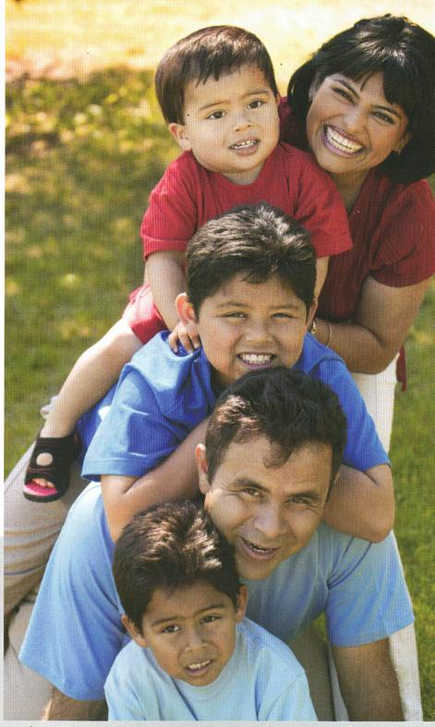
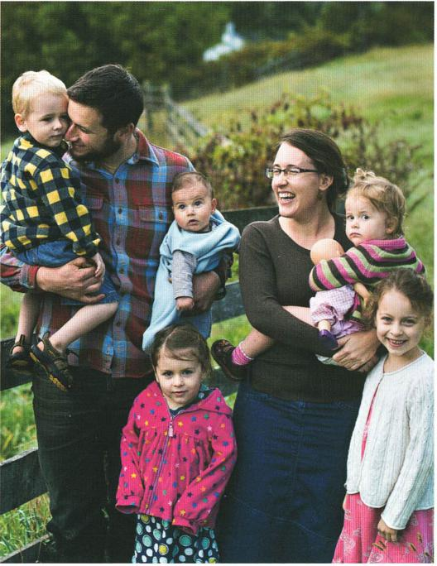
Strengthening Catholic Families
A Family of Families
The Knights of Columbus was founded to strengthen and protect Catholic
family life, and does so by providing spiritual catechesis, moral support and
financial assistance.
Founded for Families
When a man joins the Knights of Columbus, his entire family benefits. Membership provides families with spiritual, civic and social programs based in their parishes and communities.
Protecting Catholic Families
Available exclusively to members and their families, the Knights of Columbus' wide range of life insurance products and annuities helps families secure their financial futures. Recognized year after year by the industry for its fiscal strength and ethical standards, Knights of Columbus Insurance also stands proud of its customer service. Every agent is a brother Knight serving fellow Knights in his own community.
Building the Domestic Church
The Building the Domestic Church initiative is the centerpiece of the Knights of Columbus' continued efforts to strengthen family life. The program emphasizes prayer, reflection, catechesis and works of charity.
A Charity Focused on Families
Knights and their families understand the importance of caring for others in need. They participate in various service programs, including Coats for Kids, Food for Families and the Ultrasound Initiative. They also help needy families by providing educational and housing assistance.
Overseas, the Christian Refugee Relief Fund offers essential aid and support to families that suffer religious persecution and are forced to flee their homes.
A Family Prayer
Heavenly Father, thank you for the gift of our family. Enlighten our hearts and minds that we may live more fully this vocation to love.
In our daily life and work, may we reflect the self-giving love which you, 0 Father, eternally show with your Son and Holy Spirit. Let your love be evident in the peace that reigns in our home and in the faith we process and live. May our family alway be a place of generosity, understanding, forgiveness and joy.
Kindly give us the wisdom and courage to be witnesses to your eternal design for ti family; and grant that the Holy Family of Nazareth may always guide our path to holiness as a family.
We ask this through our Lord Jesus Christ, your Son, who lives and reigns with you in the unity of the Holy Spirit, one God forever and ever.
Ame;

Slide 7
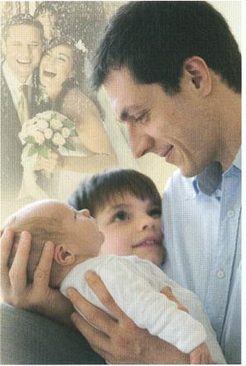
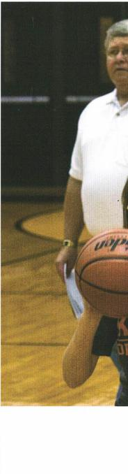
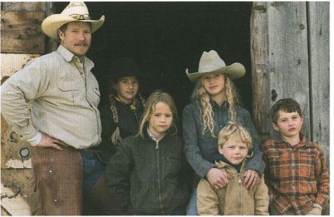
A Noble Vocation The Gift of Fatherhood | Forming Young People in the F.
Fathers for Good
Fathers are called to accept the gift, the privilege and the responsibility of their vocation. Yet in today's culture, it can be difficult for fathers to find the support they need to enhance their faith and fatherhood.
Fathers for Good is that support. This web-based initiative offers resources for fathers and their families to live out their Catholic faith as they build the domestic church in their homes.
Follow the Conversation:
fathersforgood.org
Facebook I Fathers for Good
Website Highlights:
Articles to help you strengthen your marriage
Q&A on fatherhood, marriage, family and faith
Videos on masculine virtue
How to balance work and home life
And stories from parents just like you!
This isn't an initiative only for men — wives are welcome as well. Families can grow together in their faith and love as they use the resources shared on Fathers for Good.
ather Michael J. McGivney's vision for ^{r} families stressed social and spiritual development, particularly in young people. Now, more than 130 years later, through its many youth-focused programs and initiatives, the Knights of Columbus continues to provide
children across the world with basic necessities and opportunities.
In this past year, the Knights of Columbus provided:
More than 80,000 winter coats
$300,000 for the education of children orphaned by AIDS
$1.7 million in scholarships
The Knights of Columbus provides youth with spiritual formation resources through the online resource center, Catholic Information Service.
Additionally, each year the Knights of Columbus provides scholarships to young people attending Catholic colleges and universities around the world, as well as spiritual and financial support to seminarians and religious men and women through its Refund Support Vocations Program.
Knights of Colun Youth-Oriented I
Coats for Kid:
Food for Faini
Healing Haiti
Keep Christ i Poster Contef
Soccer Challe Free-Throw C
Catholic Citi Contest
Substance Ab Poster Conte
A Father Is a Work in Progress
A father's work is never done — in what he can learn from his family and teach his children, in the sacrifices he can make, and in the love he can give and receive.
A Father Is Called by God the Father
Fathers who seek to live their faith experience the grace of their vocation every day. By responding to God's call, and by modeling their lives after St. Joseph, patron of fathers, dads can bring themselves and their families closer to God.
A Father Is an Ordinary Man
Ordinary though fathers may be, they are equipped to do extraordinary things. Each father is called to be involved with his family, provide an example for his children, and serve as a source of strength for his wife.
Be that man . . . Become a father for good! |  | The Knights of Columbus highlights the power of charity and fosters in young people a commitment to a lifetime of service.

Slide 8
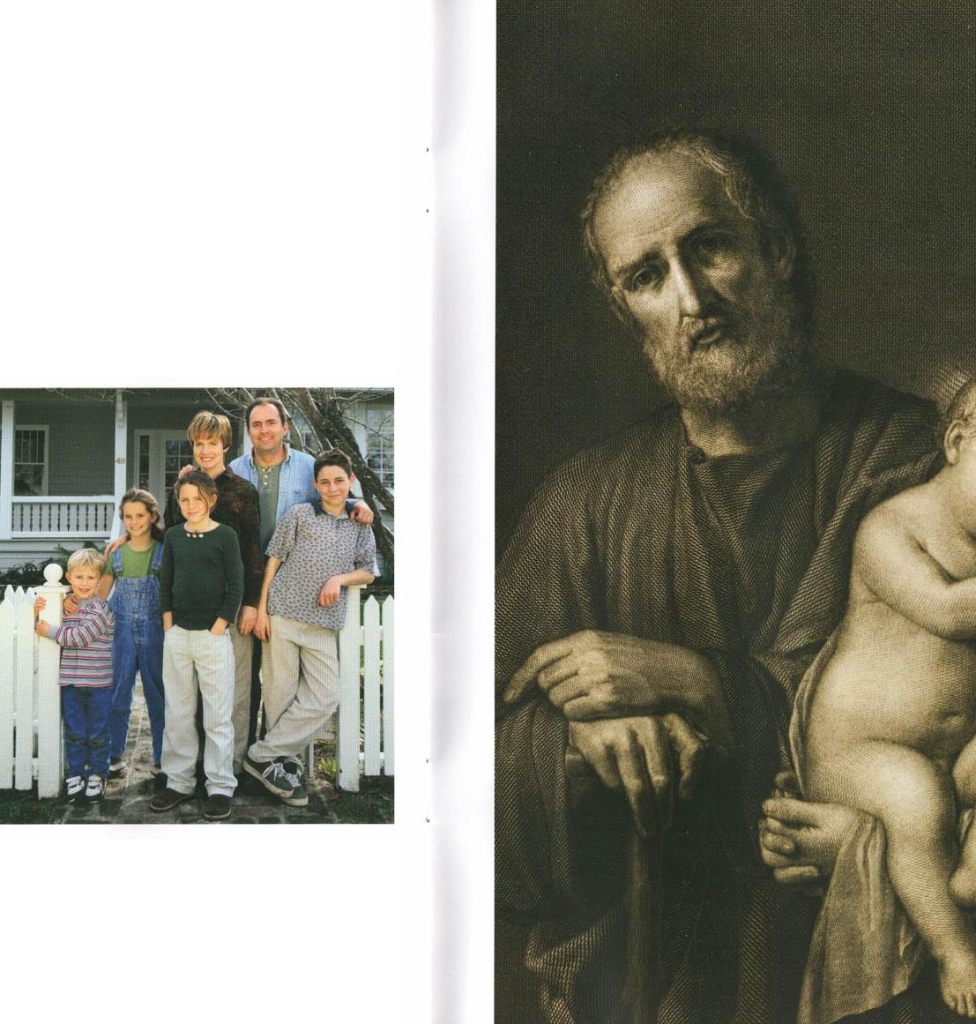
Building the Domestic Church
Each Family is a Domestic Church
"The family is, so to speak, the domestic church. In it parents should, by
their word and example, be the first preachers of the faith." (Lumen Gentium).
AA domestic church is a Christian family which, strengthened by the graces of the sacrament ..of matrimony, lives together in a community of prayer; learns about the faith, human virtue and Christian charity; and helps evangelize the world.
In promoting each family as a domestic church, the Knights of Columbus seeks to highlight the importance of Christian family life. The family is the first place where we learn about joy and love; each family thus plays a central role in the Church's joyful mission of evangelization.
Responding to the Challenge
In Amoris Laetitia, Pope Francis asked, "Who is making an effort to strengthen marriages, to help married couples overcome their problems, to assist them in the work of raising children and, in general, to encourage the stability of the marriage bond?" The Knights of Columbus Building the Domestic Church While Strengthening Our Parish initiative directly responds to this challenge.
Through the initiative's programs and activities, the Knights of Columbus offers tools and materials which may help families grow and find the encouragement they need. By building upon long-established programs and developing new ones, the Knights of Columbus hopes to help each family participate in the Church's mission of evangelization, strengthen our parishes and establish our councils as revitalized centers of lay leadership for the Church.
Domestic Church Activities
Family Fully Alive
Holy Family Prayer Program
Family Rosary Program
Journey to the Inn
Father's Day Affirmation of Wedding Vows
Prayer of Consecration to the Holy Family
Simple Supper & Stations
Keep Christ in Christmas Campaign
Into the Breach
Family Week Celebrations
"The family as domestic church is central to both the work of the new evangelization and to the future sustainability of our parishes ... the Knights of Columbus is providentially positioned to play a key role in the new alliance between the Church and family."
- Supreme Knight Carl Anderson

